Slide 1
OpenMP-Programming training-6
Chun-Yuan Lin

Slide 2
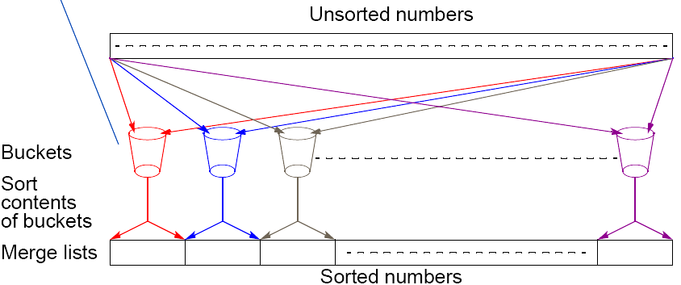
Bucket sort
One “bucket” assigned to hold numbers that fall within each region.
Numbers in each bucket sorted using a sequential sorting algorithm.
Sequential sorting time complexity: ty = n + m((n/m)log(n/m» = n + nlog(n/m) = O(nlog(n/m)) (traditional sorting: nlogn)
Works well if the original numbers uniformly distributed across a known interval, say 0 to a - 1.
4.9

Slide 3
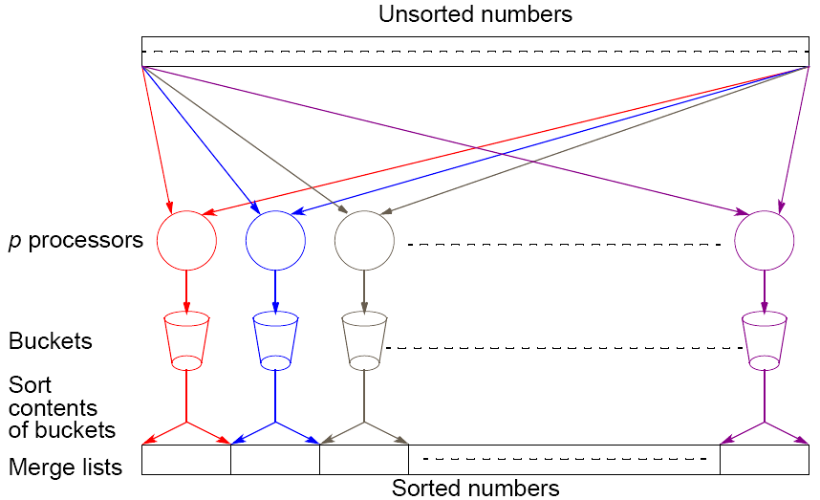
Parallel version of bucket sort
Simple approach
Assign one processor for each bucket.
4.10

Slide 4
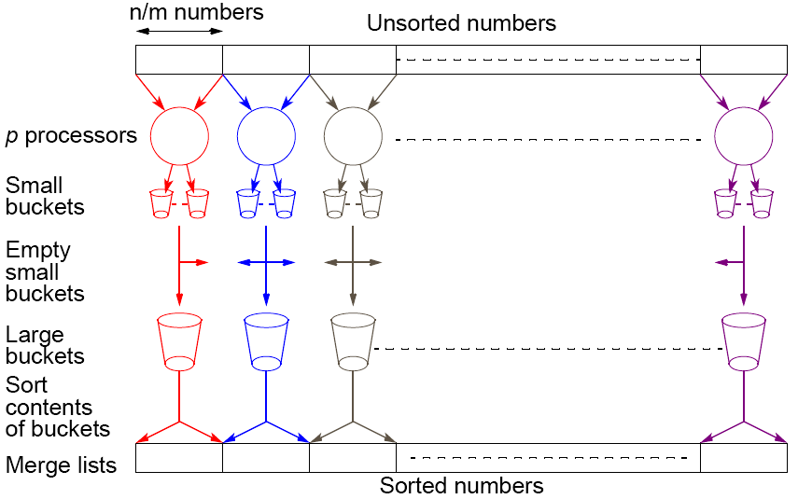
Another parallel version of bucket sort
Introduces new message-passing operation - all-to-all broadcast.
4.12

Slide 5
Training
Please write a OpenMP program to sort a list with 100,000,000 numbers, each between 0 and 99999 using bucket sort technique.
Calculate the speedup ratio for p=2, 4, 8, 16.
Please compare the OpenMP program with your previous MPI program in terms of time and speedup ratio.

Slide 6
Please send the code of this training and the word file with the speedup ratio to my email. (before 5/29, 23:59).
  Please annotate your name and your student ID in email.
  The file name is “student ID”. If more than one file, the names are “student ID-1”, “student ID-2”, etc.
  Please compress the files to a .zip or .rar file. The file name is “student ID-train6”.
For example, a student has ID “A0000001” and two files. The file names are A0000001-1.c and A0000001-2.c and the compressed file name is A0000001-train6.zip.
The file will be rejected without following the rules.

